Slide 1
Topics
Memory Management
What is it and why do we care
Stack vs. Heap
Manual vs. automatic management
Reference counting

Slide 2
Memory as a resource
If we see the memory as a resource, it’s the way we manage that resource.
From the OS point of view:
You need to provide portions of memory to programs on request, and free it when not used anymore
You need to abstract real memory from what the program sees, to provide isolation (virtual memory)
You need to implement techniques to extend the available memory (paging, swapping, ...)
From the program point of view:
We need to prevent leaks. A leak is a region of memory requested to the OS and not tracked anymore by the application.
We need to organize data to be quickly accessible by the CPU
Notes:
What is a leak from the OS POV?

Slide 3
Stack vs. Heap
The Stack
Linear, contiguous memory region
Automatically managed by the runtime
LIFO (Last-In-First-Out) allocation model
Each function call creates a new frame
Frame deallocated automatically on function return
Small, fixed size (typically 1-8 MB)
Fast access due to processor caching
Lifetime: scope-dependent
The Heap
Dynamically allocated region
Manually managed (C/C++) or garbage-collected (Java, JS, Python)
Fragmented allocation model
Programmer controls allocation and deallocation
Large size (depends on available system RAM)
Slower access compared to stack
Lifetime: scope-independent
Notes:
What is a leak from the OS POV?

Slide 4
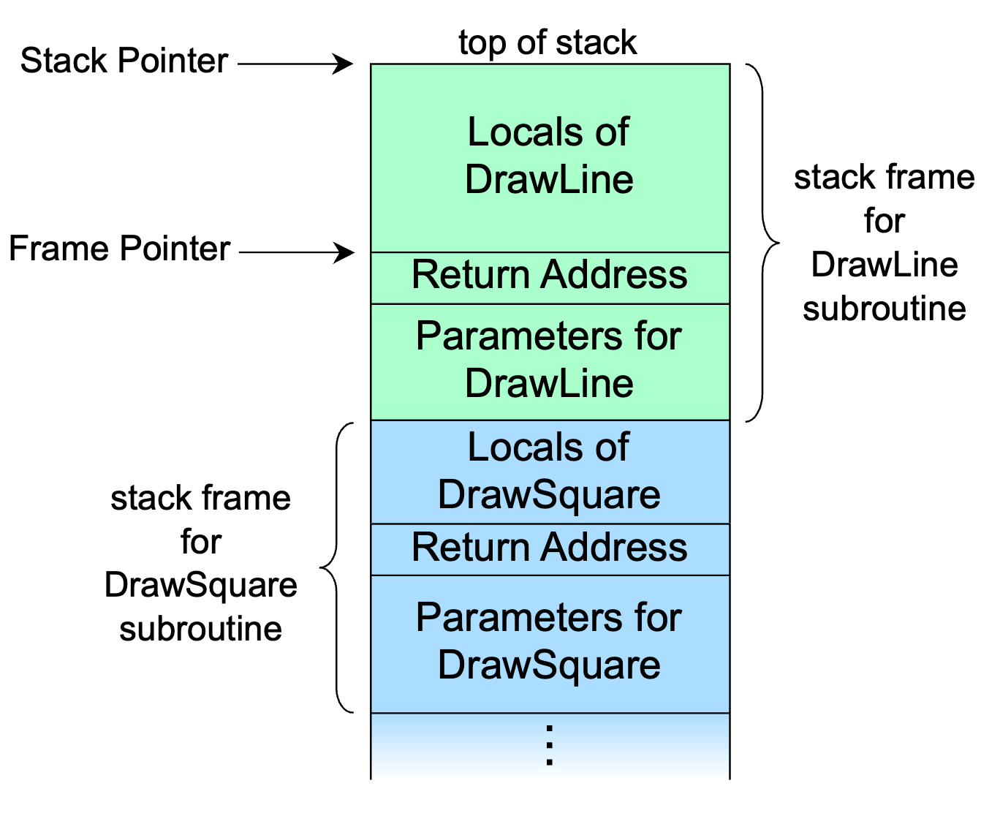
Manual Allocation - Stack
Few languages support stack (a.k.a. automatic storage) allocation: C/C++, Rust, Go*, Swift*.
C/C++ has a buffer allocation on stack via alloca.
Be aware of the memory data alignment!
Variables are allocated when defined:
int DrawLine(double x1, double x2) {
int k1;
alignas(8) bool k2;
...
...
}

Slide 5
Manual Allocation - Stack
C++ allows a really nice programming idiom to handle memory in a reliable way, using stack: RAII (Resource Acquisition Is Initialization)
class MyClass {
public:
char *buf;
MyClass();
~MyClass();
...
};
MyClass::MyClass() :
buf(new char[10000]) {
}
MyClass::~MyClass() {
delete buf;
}
void myFunc(....) {
MyClass c;
c.buf[0] = ‘A’;
...
}
RAII is an idiom that can guarantee a Basic (Weak) Exception Safety.

Slide 6
Manual Allocation - Heap
Almost all programming languages support heap allocation, either explicitly or implicitly.
When allocation is performed manually (ex., when using C/C++, via malloc, new, ...), continuous allocations/deallocations could cause fragmentation, thus slowdowns.
Countermeasures:
custom allocators that requests huge chunks of memory to the OS and split them in pools
write data structures that reserve space in advance
Rust (manual, unsafe)
int main() {
int *ptr = (int *) malloc(sizeof(int));
*ptr = 42;
free(ptr);
return 0;
}
unsafe {
let layout = Layout::new::<i32>();
let ptr = alloc(layout) as *mut i32;
*ptr = 42;
dealloc(ptr as *mut u8, layout);
}
C
int main() {
int *ptr = new int(42);
delete ptr;
return 0;
}
let x = Box::new(42);
Rust (automatic)
C++
Notes:
- Sometimes could be worth wasting a bit of memory to push up performance - KNOW YOUR DATA! - Example: short string optimization

Slide 7
Automatic Allocation - Heap
All variables are allocated on the heap by the language support, garbage collection kicks in when those variables are not used anymore.
Advantages:
programmers don’t have to care anymore about allocations/deallocations
there are no dangling pointers, no access to memory that has been deallocated (=> crash)
Disadvantages:
lower performance
deallocation out of programmer’s control (we don’t have a destruction stage)
How does the garbage collector know when it’s time to clean up? Two ways:
Tracing: GC determines which objects are reachable and which are considered as “garbage”, and deallocates them with its own strategy
Reference counting: GC deallocate an object as soon as there are no more references to it

Slide 8
Automatic Allocation – RAII-like
Some languages offer a RAII-like approach, like Java, Python & Javascript (most recent ES)
public class DatabaseConnection implements AutoCloseable {
private Connection conn;
public DatabaseConnection(String url) throws SQLException {
this.conn = DriverManager.getConnection(url);
// Acquire
}
public void query(String sql) {
// Use resource
}
@Override
public void close() {
// Release
try
{
if (conn != null) {
conn.close();
}
} catch (SQLException e) {
e.printStackTrace();
}
}
}
PYTHON class FileManager:
def __init__(self, filename, mode):
self.filename = filename
self.mode = mode
def __enter__(self):
self.file = open(self.filename, self.mode)
return self.file
def __exit__(self, exc_type, exc_value, traceback):
self.file.close()
# using the custom context manager
with FileManager('example.txt', 'w') as file:
file.write('Hello, World!')
public void processDatabase() {
try (DatabaseConnection db = new DatabaseConnection("jdbc:...")) {
db.query("SELECT ...");
} // close() called automatically here, even on exception
catch (SQLException e) {
// Exception still propagates, resource released
}
}

Slide 9
Strong vs. weak references
The GC can reclaim only objects that have no references pointing to them.
Ordinary references are called “strong”, that means, as long as they point to something, GC is not allowed to claim its space.
Strong references can lead to circular references, and so generate leaks.
class A {
constructor(b) {
this.b = b;
}
}
class B {
setA(a) {
this.a = a;
}
}
A
B
const y = new B();
const x = new A(y);
y.setA(x);
x = undefined;
y = undefined;
// memory for A and B is still there!
x
y

Slide 10
Strong vs. weak references
Weak references to the rescue!
A weak reference is a reference that does not protect the referenced object from GC. The object is considered by the GC as “unreachable”, so GC does not take weak refs into account.
For reference counting, that means that a weak reference does not change the reference counter.
class A {
constructor(b) {
this.b = b;
}
}
class B {
setA(a) {
this.a =
new WeakRef(a);
}
}
const y = new B();
const x = new A(y);
y.setA(x);
x = undefined; // => A is removed, there’s no ref to it
y = undefined; // => B is removed, there’s no ref to it
// no leaks
x
A
B
y

Slide 11
Hidden leaks: Observer pattern!
public class EventPanel extends JPanel {
public EventPanel() {
Button btn = new Button("Click");
btn.addActionListener(new ActionListener() {
@Override public void actionPerformed(ActionEvent e) {
System.out.println("Clicked");
}
// Anonymous listener holds implicit reference to EventPanel (this)
// Even if EventPanel is disposed, listener keeps it alive
});
}
}
Remove the listeners once done!!!

Slide 12
Reference counting
Reference counting is a programming technique of storing the number of references, pointers, or handles
to a resource.
The reference counter is an entity shared among
all objects that access the same resource.
Once the reference counter reaches zero, the resource
is properly finalized.
Reference
Counter
A
Reference counting implements a shared ownership,
where the resource is alive as long as there are consumers.
Another resource management is unique ownership,
where an assignment from a variable holding the reference
to another translates into a resource ownership transfer
(i.e. the first variable does not have access to the resource
anymore)
B
Resource
C

Slide 13
Key takeaways
Reduce the scope of the variables
Make clear who owns what and enforce it, ownership must be explicit
Collection lifecycle: remove the items from a collection when not needed
Use a profiler if available
Java: VisualVM
Node.JS: pass “--prof” to the node process
Python: profile/cProfile library

